Slide 1




Meta-Analysis with R
Alireza Soltani Khaboushan
Researcher at PURMRC, TUMS
Structural Editor at JOST
Referee at Research Council, SSRC, TUMS

Slide 2
Contents of This Presentation
Systematic Review
Introduction to Meta-Analysis
Is Meta-Analysis Mandatory with Systematic Review?
Effect Size
Types of Meta-Analysis
Publication Bias
Meta-Regression and Subgroup Analysis
Sensitivity Analysis
Advanced Methods
Wrap-Up

Slide 3

Contact Me
Medicosine
"E-mail" : "alirezasoltanykhaboshan@gmail.com
",
"LinkedIn" : "https://www.linkedin.com/in/alireza-soltani-709848255/",
"ResearchGate" : "https://www.researchgate.net/profile/Alireza-Soltani-Khaboushan",

Slide 4
Table of Contents
01
02
03
04
Systematic Review
Meta-Analysis
Introduction to Systematic Review and Meta-Analysis
When and How To Conduct Meta-Analysis
Practice with R
Advanced Methods
Hands-on Practice on Doing Meta-Analysis with R
Multi-Level, Structural Equation, Network, and Bayesian Method

Slide 5
01
Systematic Review
Introduction to Systematic Review and Meta-Analysis

Slide 6
“A systematic review attempts to collate all empirical evidence that fits pre-specified eligibility criteria in order to answer a specific research question. It uses explicit, systematic methods that are selected with a view to minimizing bias, thus providing more reliable findings from which conclusions can be drawn and decisions made.”
-Antman 1992, Oxman 1993

Slide 7
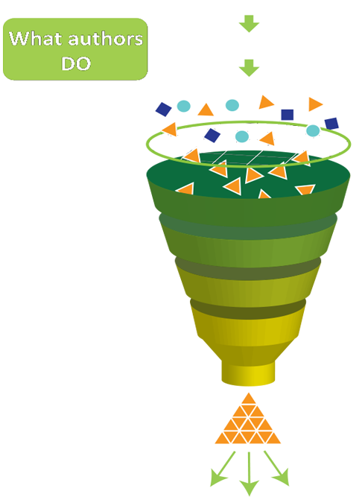
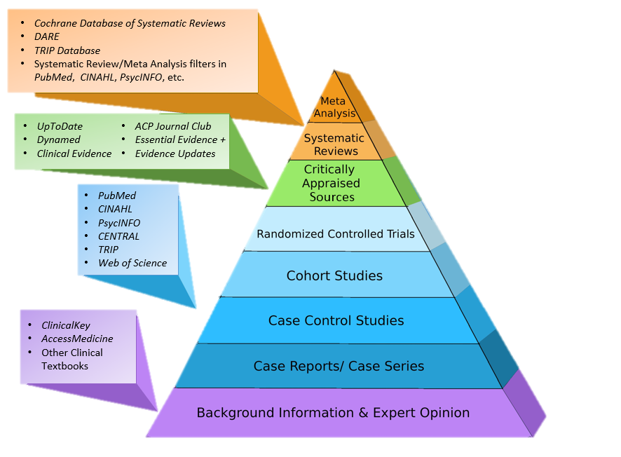
The EBM Pyramid

Slide 8
02
Meta-Analysis
When and How To Conduct Meta-Analysis

Slide 9
Why To Have a Meta-Analysis
Inconsistency
Better Presentation
Inconsistent results between the previously conducted studies
Quantitative data helps to present the result of the study in a more understandable way

Slide 10

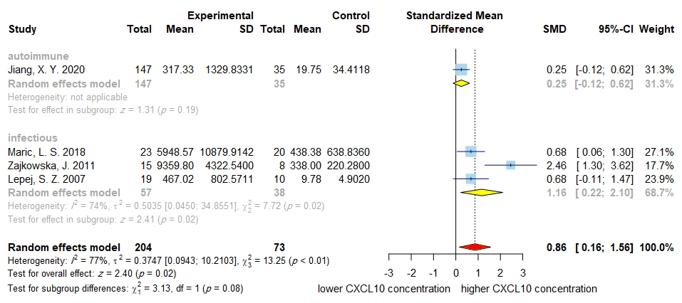
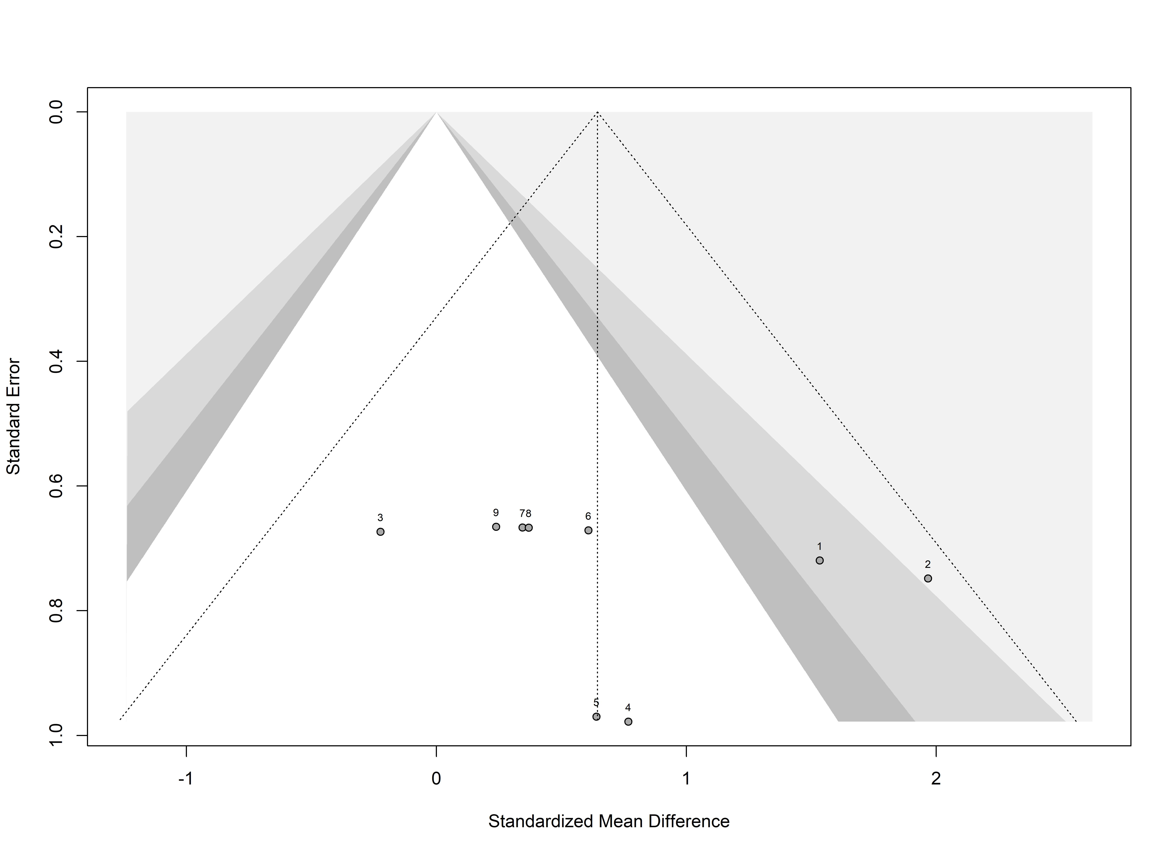
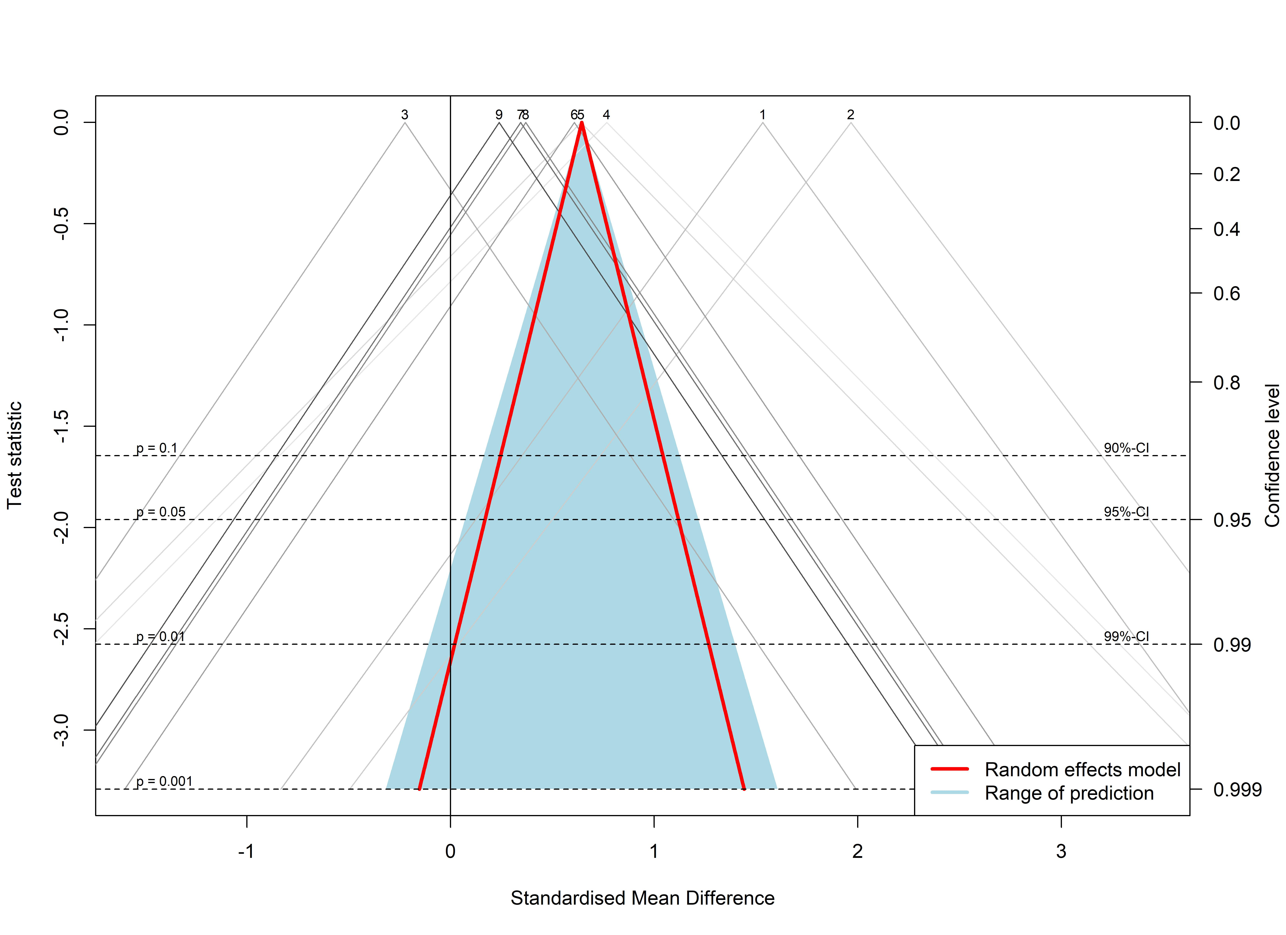
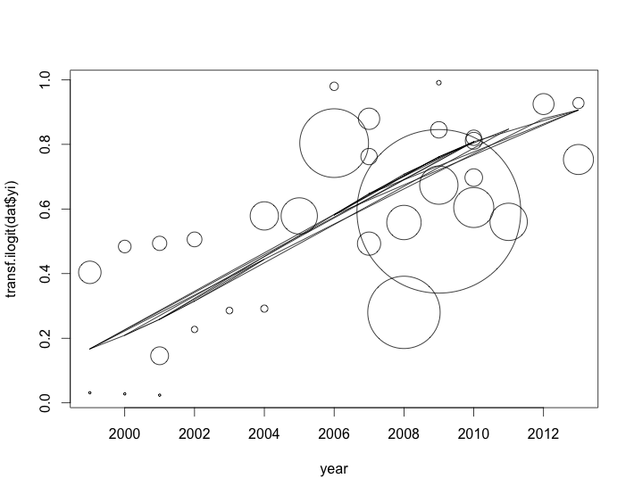
Some Figures You Usually See When Looking at Meta-Analyses

Slide 11
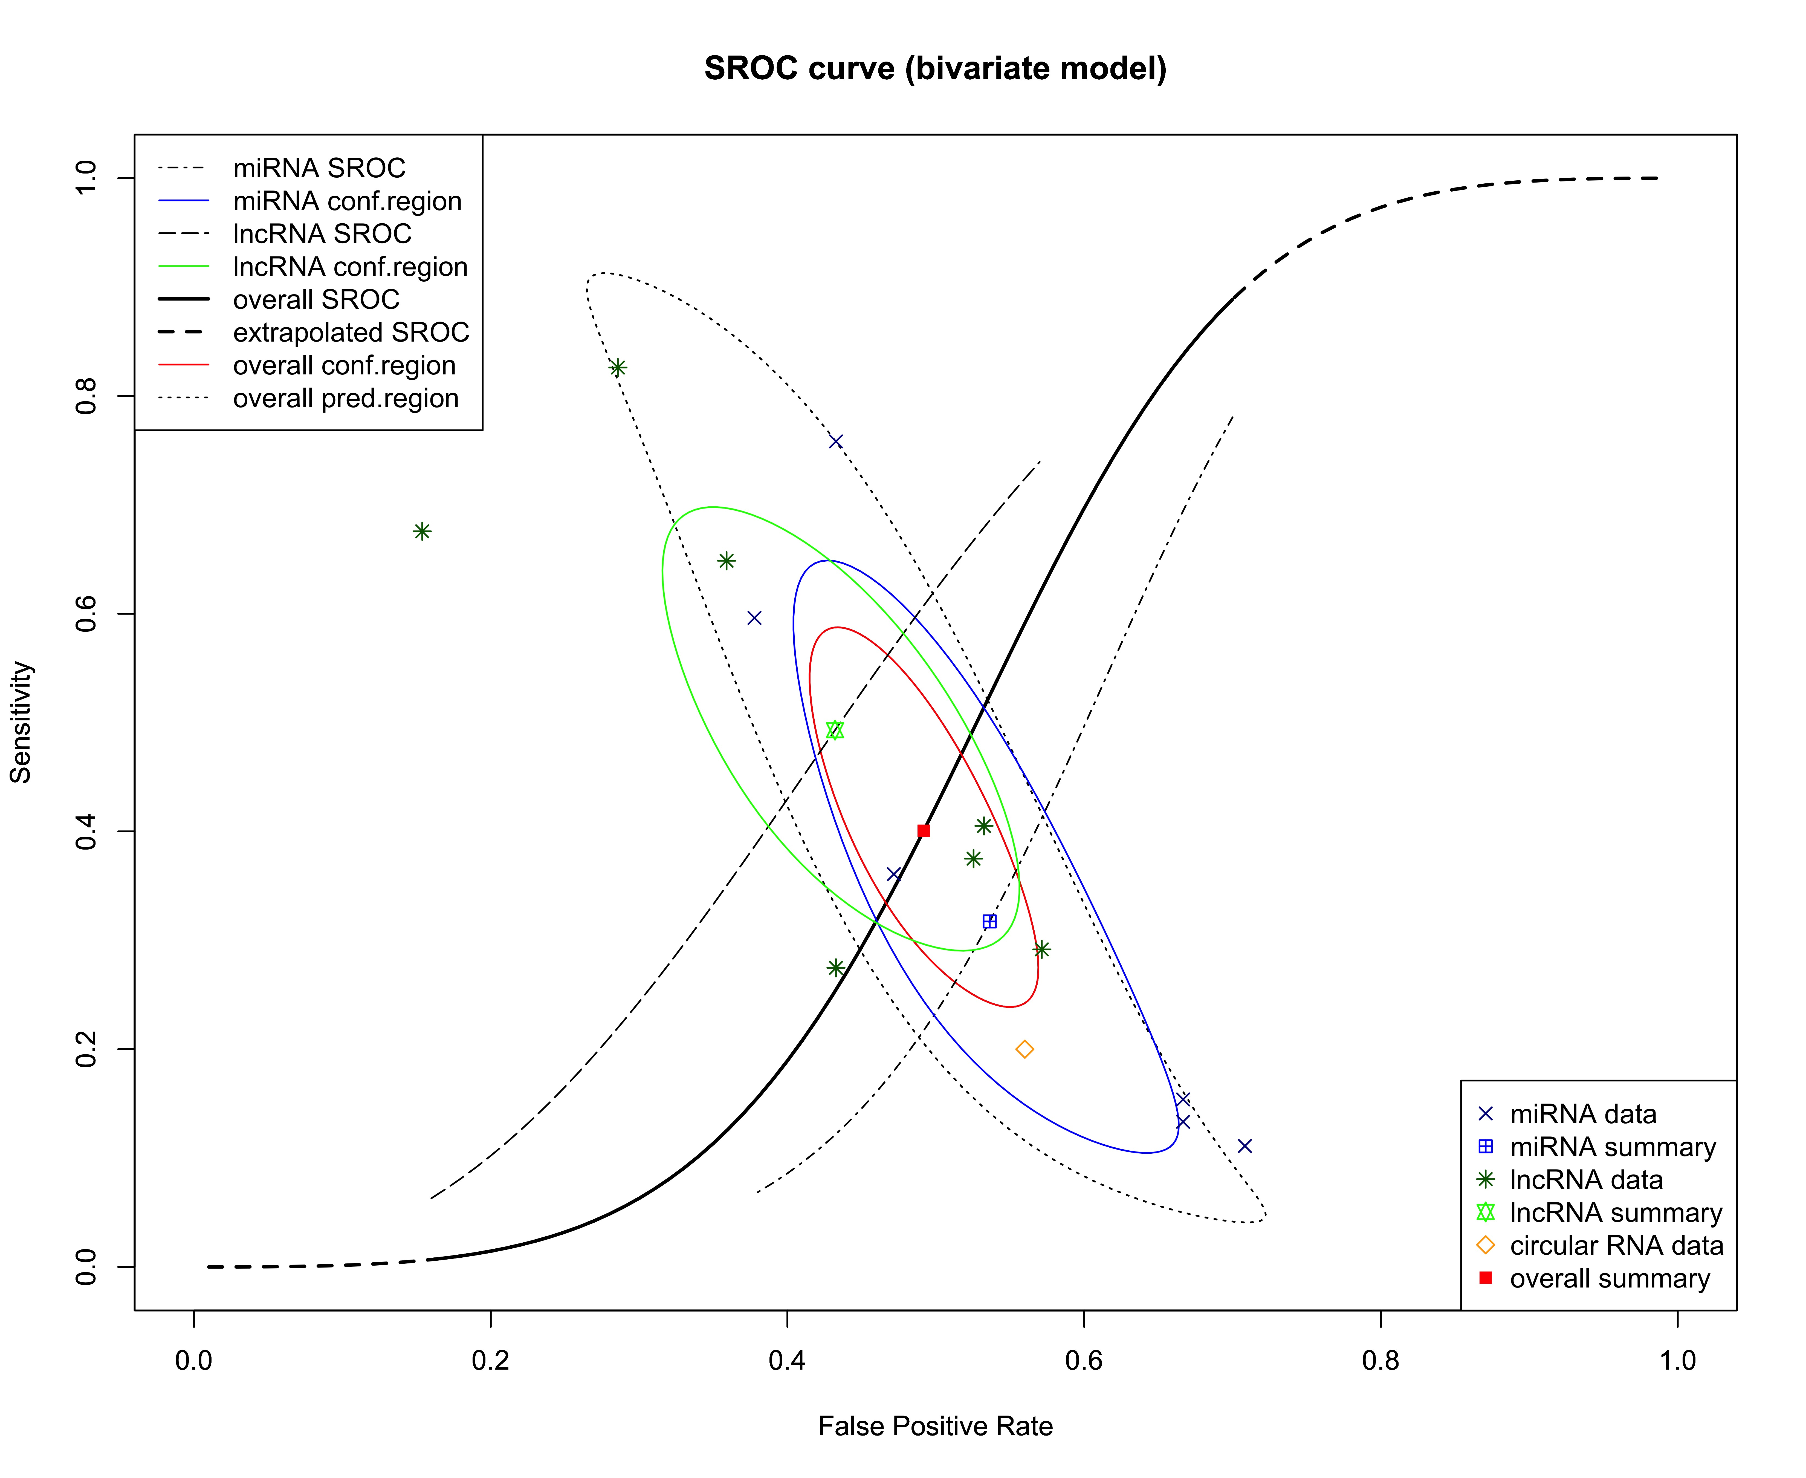
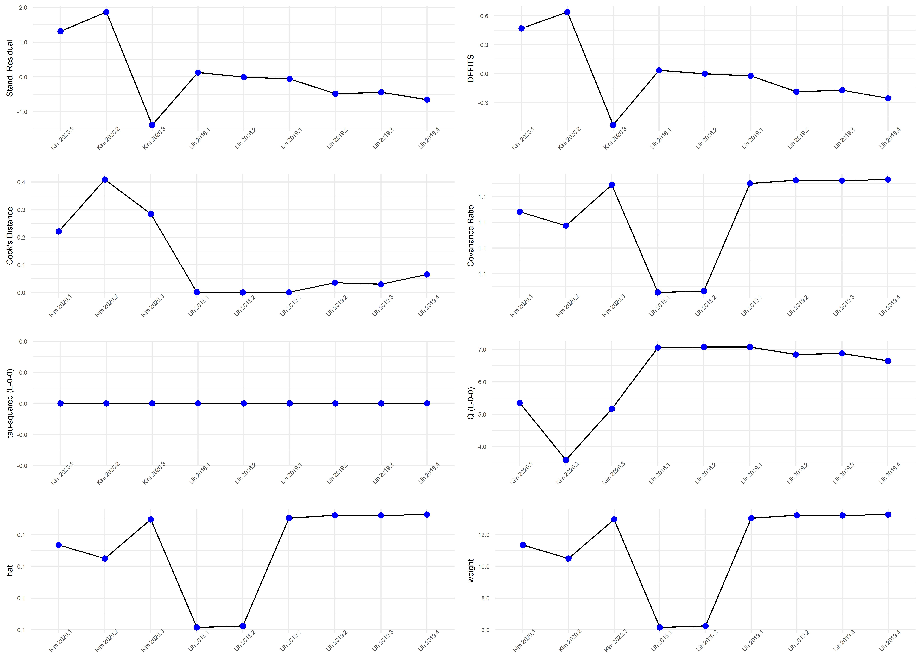
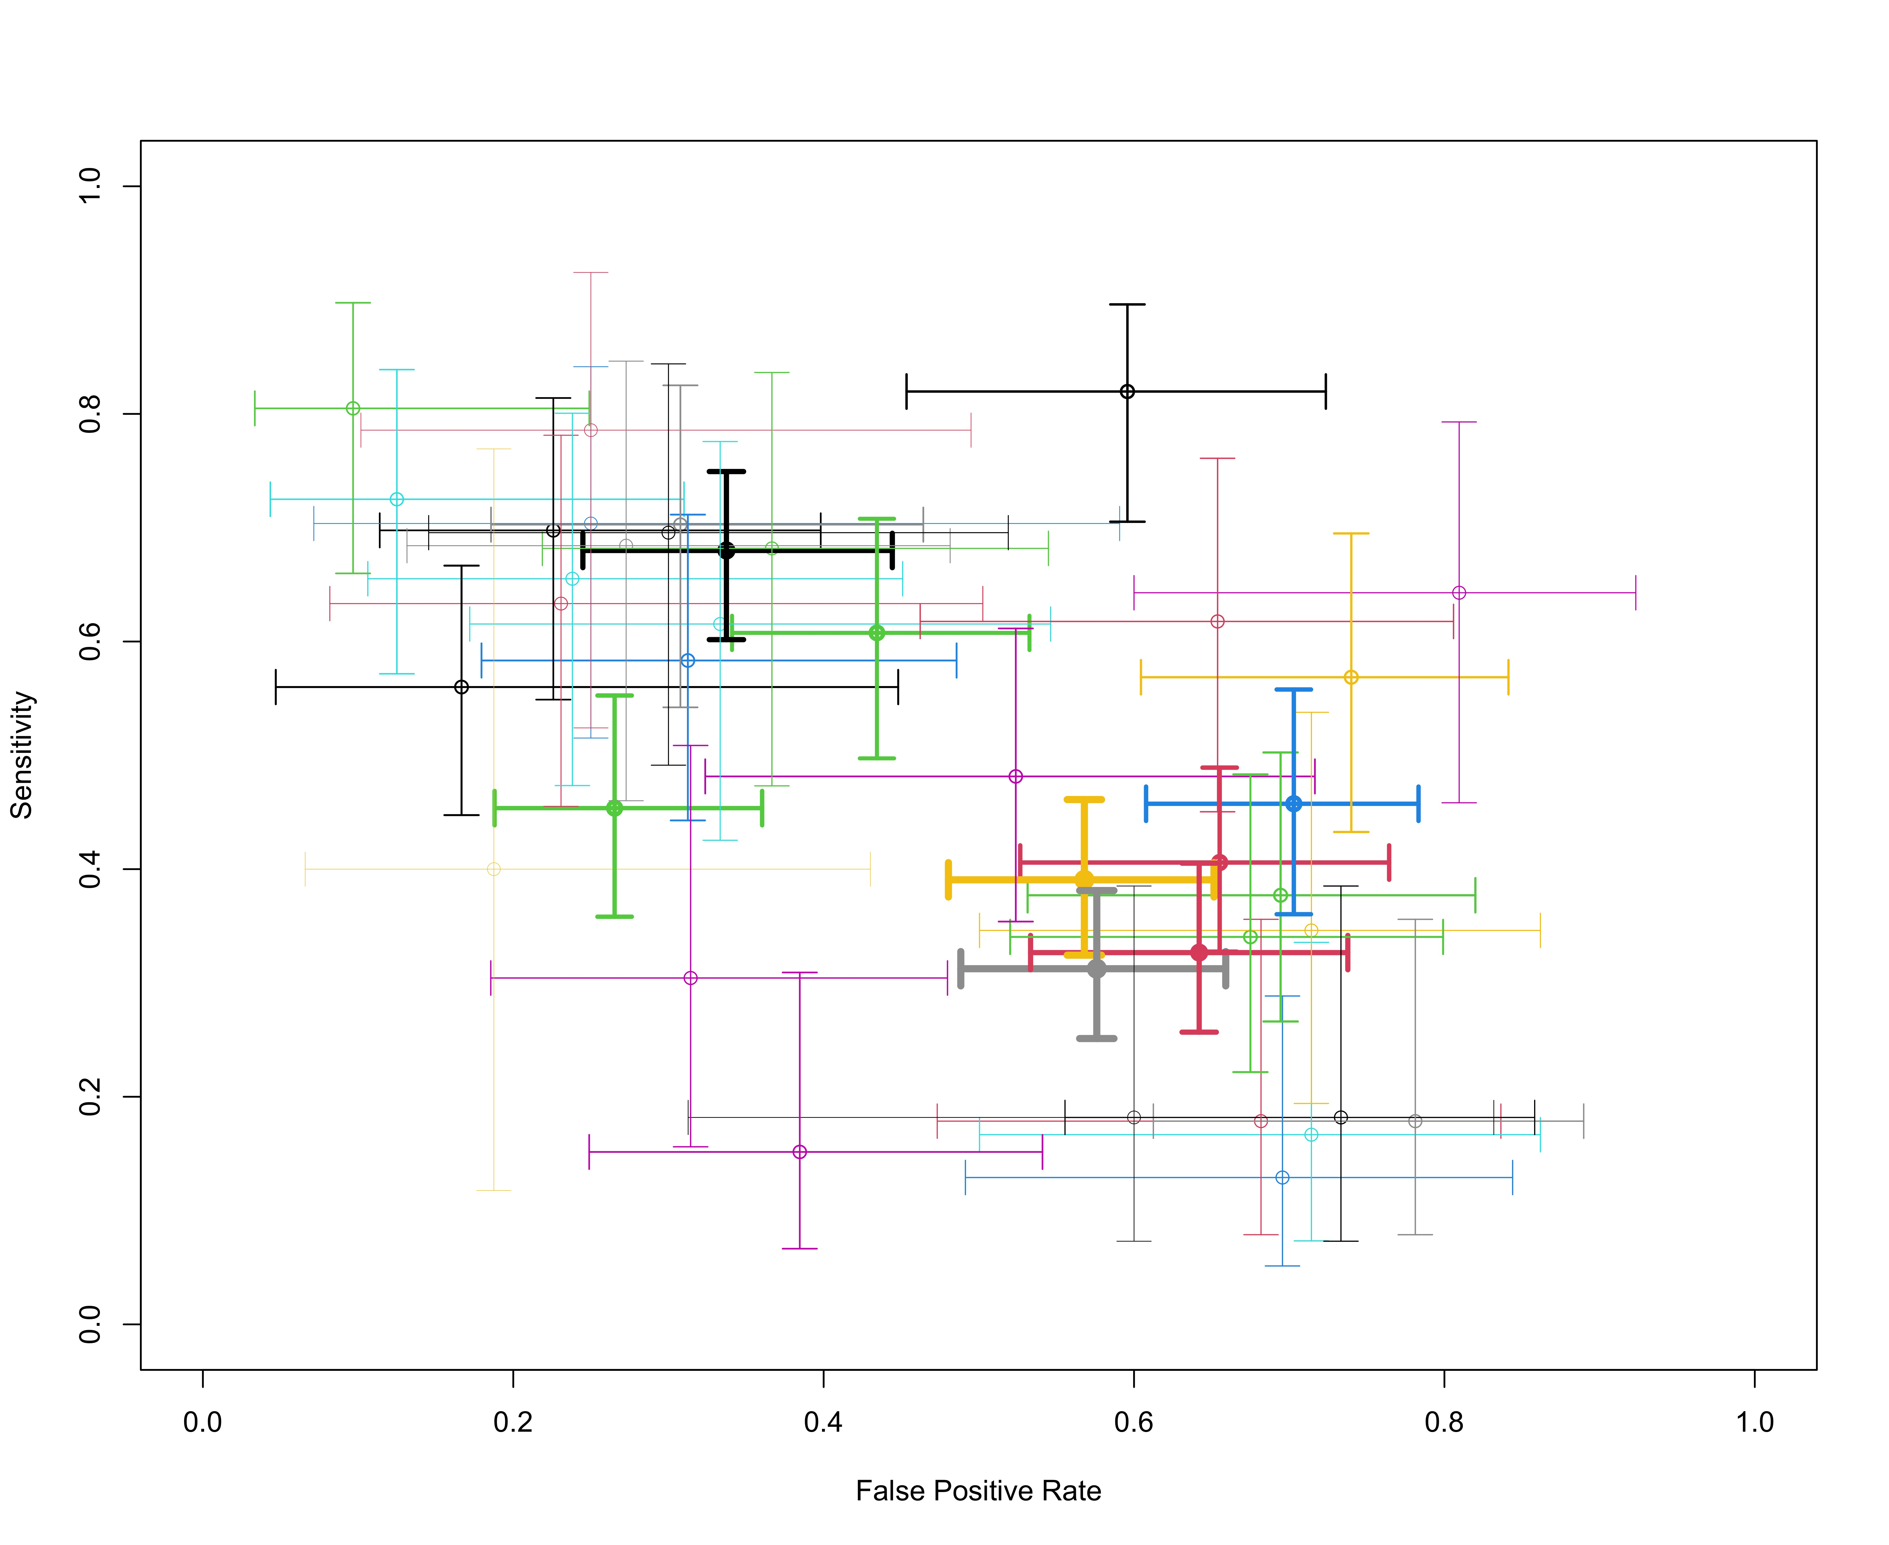
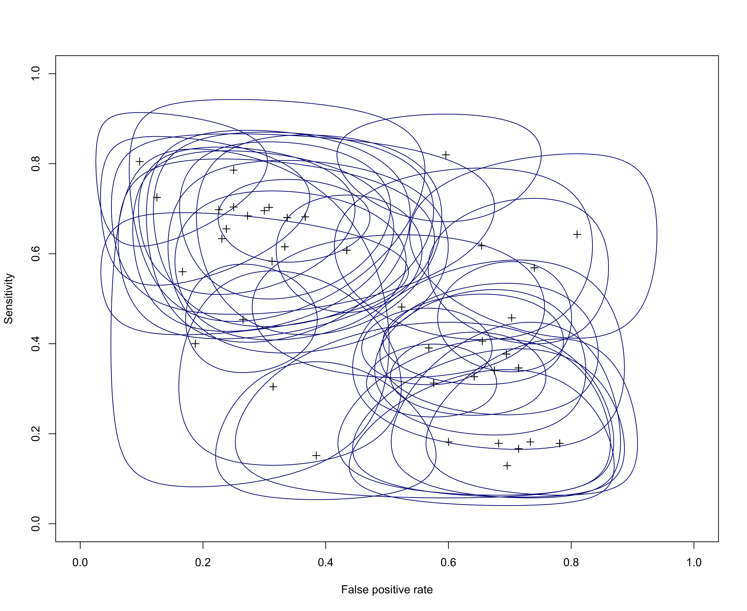
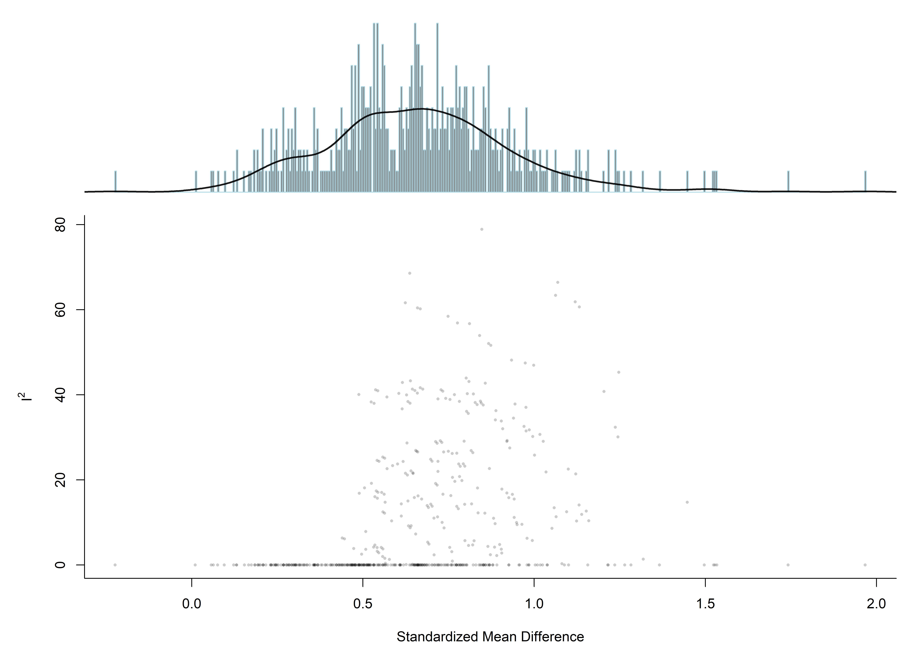
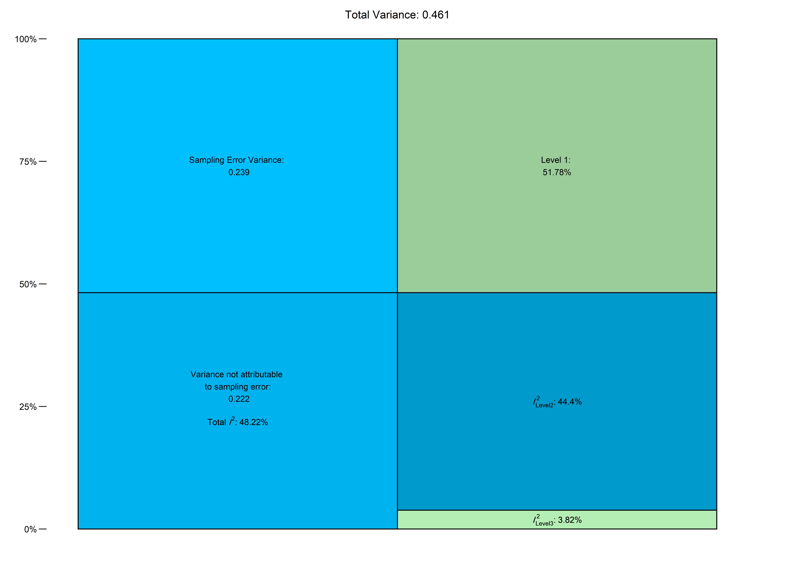
Some Figures You Cannot Usually See When Looking at Meta-Analyses

Slide 12
What is General Idea Behind Meta-Analysis?
It is Weighted Mean of Effect sizes

Slide 13
Effect Size
the effect size is a measure of the magnitude of the relationship or difference between two groups or conditions. It is used to quantitatively summarize the results of multiple studies and determine whether there is a consistent effect across studies.

Slide 14
Types of Effect Sizes
Mean
Fractions
Correlation
Proportions
Ratios
Odds
Risk
Incidence Rate Ratio
Pearson Correlation
Usually is transformed into Fisher’s Z
Single Group Mean
Standardized Mean difference
Cohen’s d
Hedges’ g
Etc.

Slide 15
Brief Insight on Calculation of Effect sizes
d = (M1 - M2) / Sdpooled
SDpooled = sqrt((SD1^2 + SD2^2) / 2)
g = d * (1 - 3/(4*N-9))
Hedges’s SMD
Log Odds Ratio
Ln(OR)
r = Σ[(Xi - x̄)(Yi - ȳ)] / [√Σ(Xi - x̄)² √Σ(Yi - ȳ)²]
SE(r) = [(1 - r²) / √(n - 2)]
z = 0.5 * ln[(1 + r) / (1 - r)]
SE(z) = 1/√(n-3)
Fisher’s Z-Transform

Slide 16
Types of Meta-Analysis
Fixed-Effect Model
A fixed-effect meta-analysis assumes that all studies included in the analysis share a common true effect size, and any variation in the observed effect sizes is due to sampling error or chance.
Random-Effect Model
A random-effects meta-analysis, on the other hand, assumes that the true effect size may vary across studies, and any observed differences in effect sizes are due to both sampling error and true variation in the effect sizes across studies.

Slide 17
Questions

Slide 18
Whoa!
Let’s take a plunge into what we can practically do …

Slide 19
03
Practice with R
Hands-on Practice on Doing Meta-Analysis with R

Slide 20
Four Sample Analyses
 | Type | Data | Multiple Groups
Task 1 | Percentage | dat.baker2009
Task 2 | SMD | SuicidePrevention
Task 3 | OR | DepressionMortality
Task 4 | Correlation | HealthWellbeing

Slide 21
Usual Packages for the Meta-Analysis
meta
A comprehensive package to conduct meta-analysis and present and visualize the results.
metafor
A thorough package that provide tools to calculate various effect sizes, conduct meta-analysis, and visualize results.
MAd
A comprehensive package for calculating and converting effect sizes.
rmeta
A package that provide tools to visualize meta-analysis results.
dmetar
Package guide of the “Doing Meta-Analysis in R” book.
netameta
A package for conducting network meta-analysis.

Slide 22
How to Calculate Effect Sizes
escalc() function from metafor package could be used for calculation of various effect sizes. This function gets the results statistics of studies and return the TE and seTE. Types of given data are:
Dichotomous data:
RR
OR
RD
AS (arcsine square root transformed risk difference)
PETO
If the data is not dichotomous, but it is a dichotomized version of quantative data:
"PBIT" for the probit transformed risk difference as an estimate of the standardized mean difference,
"OR2DN" for the transformed odds ratio as an estimate of the standardized mean difference (assuming normal distributions),
"OR2DL" for the transformed odds ratio as an estimate of the standardized mean difference (assuming logistic distributions).

Slide 23
Quantitative Data:
MD
SMD
"SMDH" for the standardized mean difference with heteroscedastic population variances in the two groups (Bonett, 2008, 2009),
"SMD1" for the standardized mean difference where the mean difference is divided by the standard deviation of the second group (and "SMD1H" for the same but with heteroscedastic population variances),
"ROM" for the log transformed ratio of means (Hedges et al., 1999; Lajeunesse, 2011).
Transformed Log odds ratio from SMD:
"D2ORN" for the transformed standardized mean difference as an estimate of the log odds ratio (assuming normal distributions),
"D2ORL" for the transformed standardized mean difference as an estimate of the log odds ratio (assuming logistic distributions).
differences between the two groups with respect to their variability:
"CVR" for the log transformed coefficient of variation ratio,
"VR" for the log transformed variability ratio.

Slide 24
Event Count:
"IRR" for the log incidence rate ratio,
"IRD" for the incidence rate difference,
"IRSD" for the square root transformed incidence rate difference.
Variable Association:
"COR" for the raw correlation coefficient,
"UCOR" for the raw correlation coefficient corrected for its slight negative bias (based on equation 2.3 in Olkin & Pratt, 1958),
"ZCOR" for Fisher's r-to-z transformed correlation coefficient (Fisher, 1921).

Slide 25
Meta-Analysis Using meta package
Importing the data
Inspecting the data and choosing the effect size
Doing the meta-analysis
Drawing the forest plot
Drawing funnel plot
Checking publication bias
Sensitivity and influence analysis
Trim and fill
Gosh plot (metafor)

Slide 26
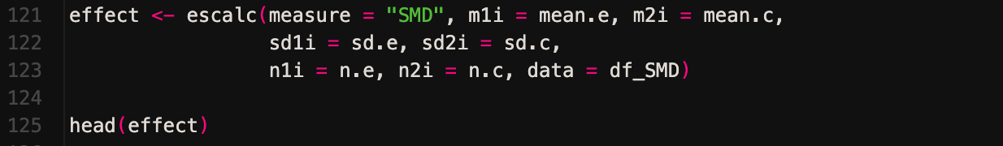
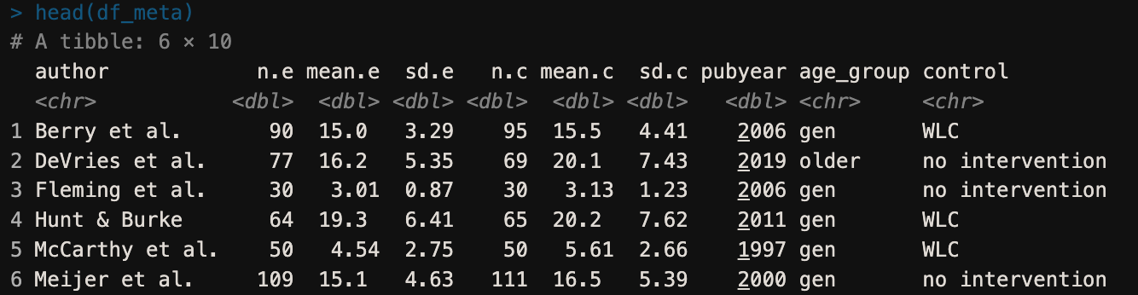
Meta-Analysis Using meta package
Importing the data
Inspecting the data

Slide 27
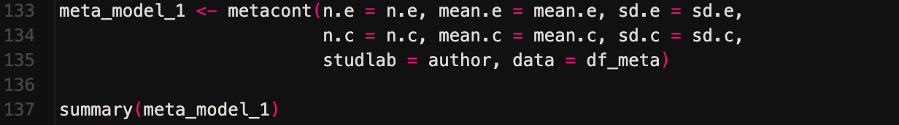
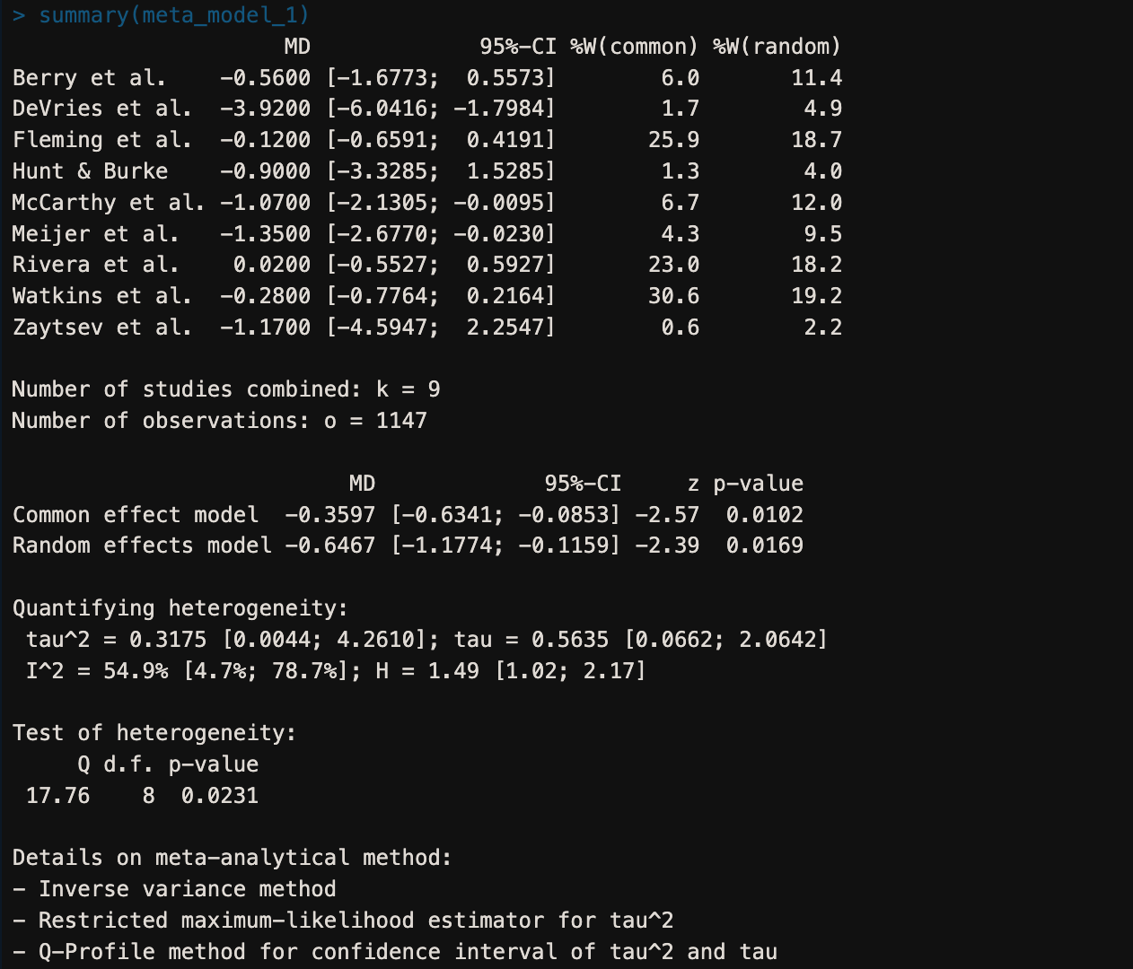
Meta-Analysis Using meta package
3. Doing Meta-Analysis

Slide 28
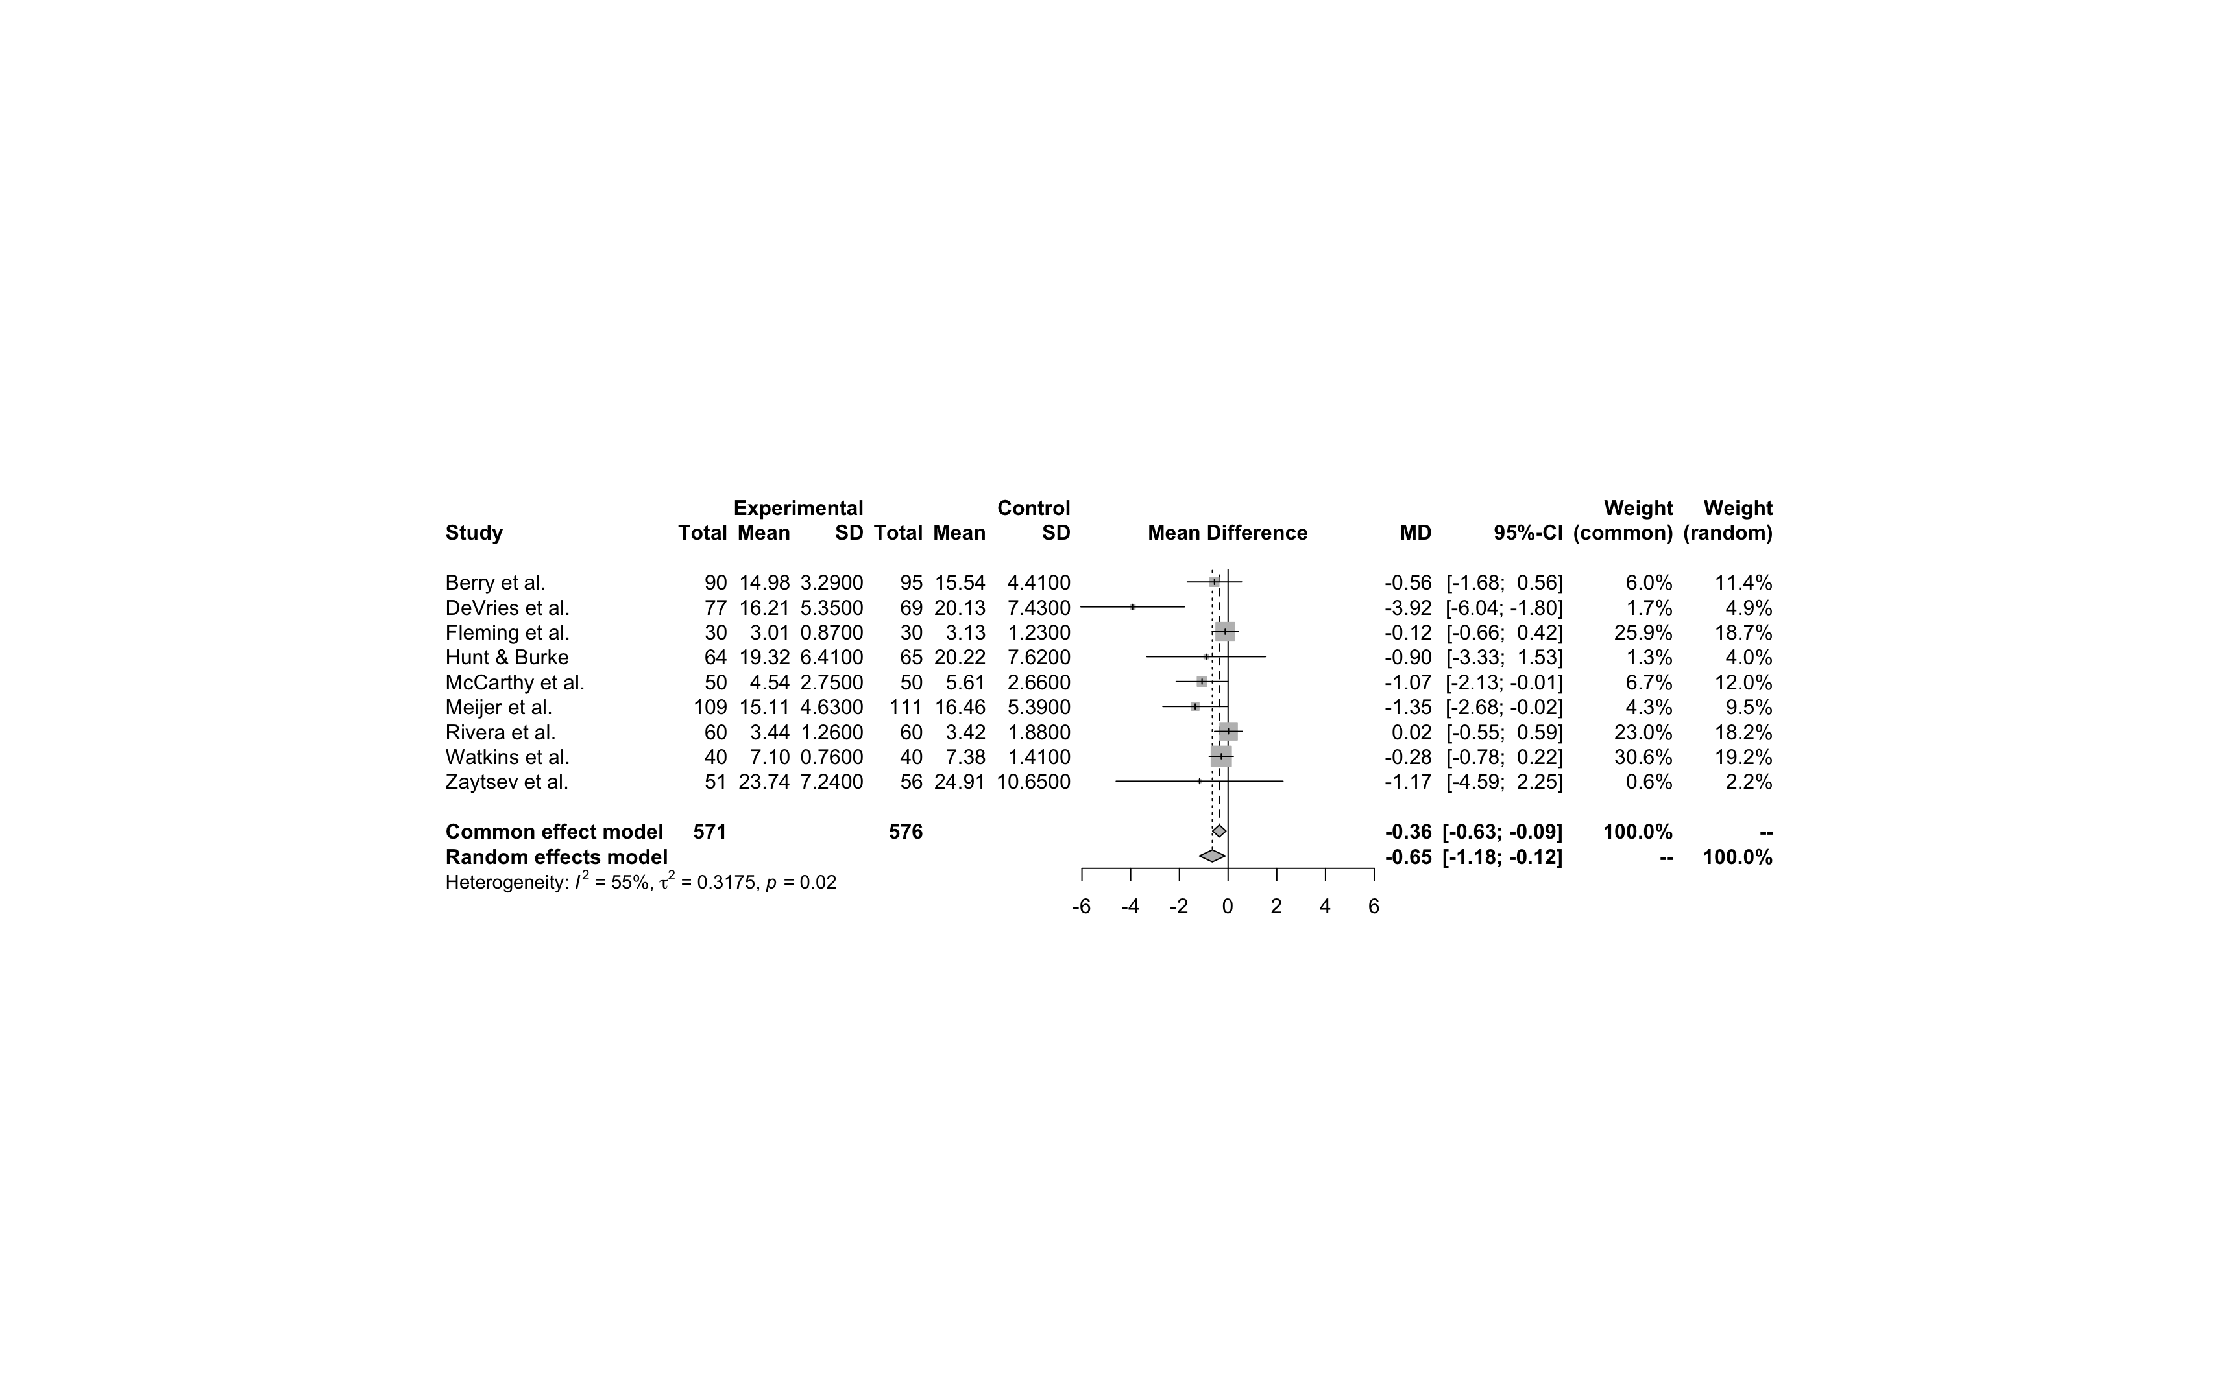
Meta-Analysis Using meta package
Forest Plot

Slide 29
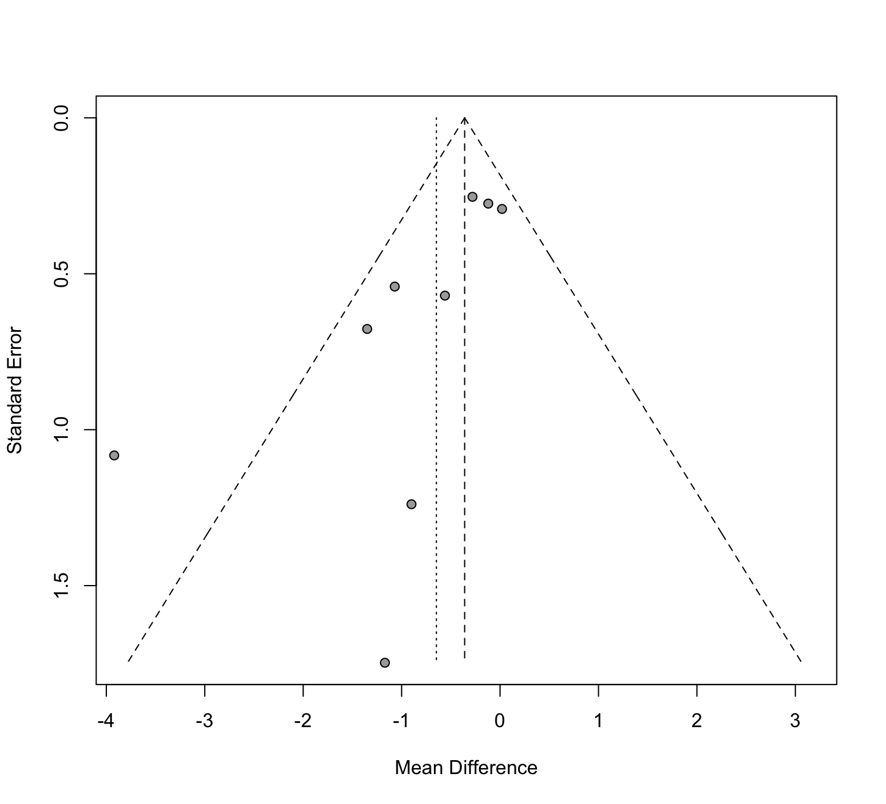
Meta-Analysis Using meta package
Funnel Plot

Slide 30
Meta-Analysis Using meta package
Funnel Plot

Slide 31
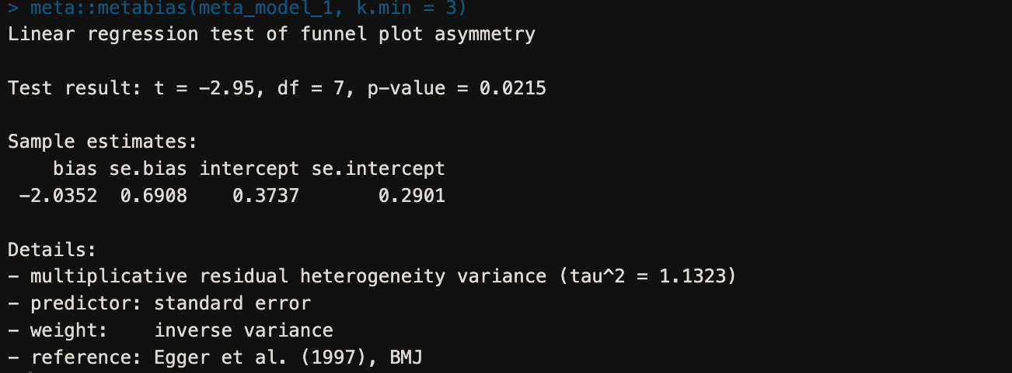
Meta-Analysis Using meta package
6. Publication Bias

Slide 32
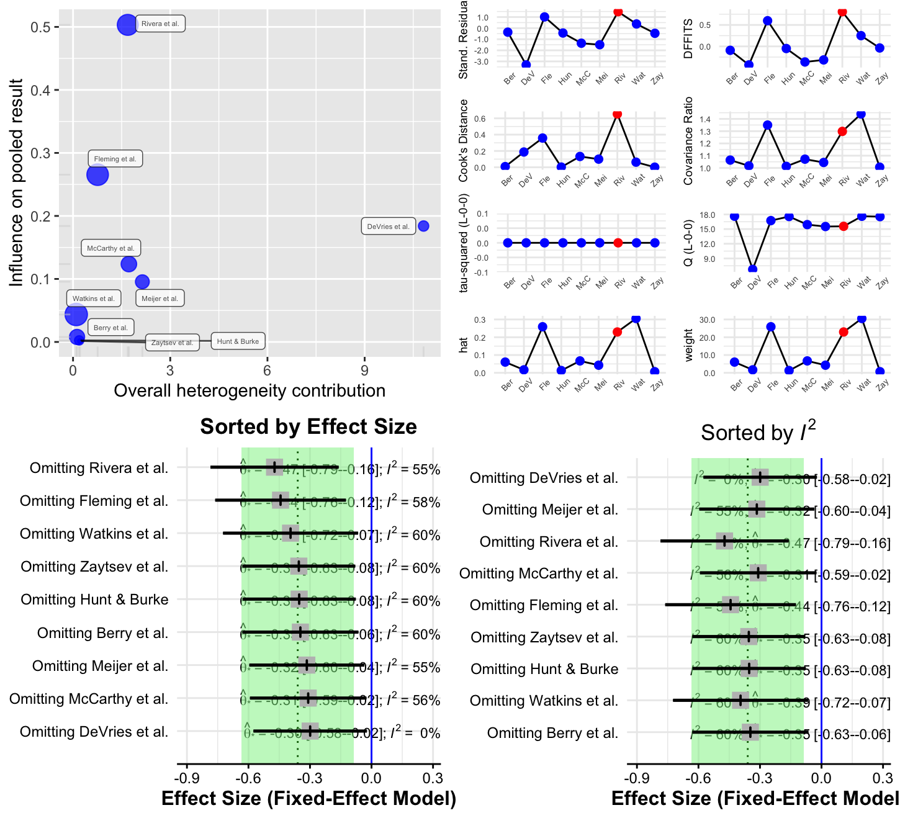
Meta-Analysis Using meta package
7. Influence Analysis

Slide 33
Meta-Analysis Using meta package
7. Influence Analysis

Slide 34
04
Advanced Methods
When and How To Conduct Meta-Analysis
Advanced Methods

Slide 35
References
Doing meta-analysis with r a hands-on guide, Mathias Harrer
Discovering Statistics Using R, Andy Field
Meta-analysis with r, Gerta Rücker, Guido Schwarzer, and James Carpenter
How to perform a meta-analysis with R: a practical tutorial, Evidence-Based Mental Health, Balduzzi S, Rücker G, Schwarzer G
onducting meta-analyses in R with the metafor package, Viechtbauer, W.

Slide 36
THANKS!
Do you have any questions?
alirezasoltanykhaboushan@gmail.com
+98-9157707497
https://www.linkedin.com/in/alireza-soltani-709848255/
@medicosine

